Slide 1
Line Drawing Algorithms
A line in Computer graphics is a portion of straight line that extends indefinitely in opposite direction.
It is defined by its two end points.
Its density should be independent of line length.
the slope intercept equation for a line:
y = mx + b (1)
where, m = Slope of the line
b = the y intercept of a line
COMUTER GRAPHICS AND VISUALIZATION, Sougandhika Narayan, Asst Prof, Dept of CSE, KSIT
1

Slide 2
Digital Differential Analyzer DDA
COMUTER GRAPHICS AND VISUALIZATION, Sougandhika Narayan, Asst Prof, Dept of CSE, KSIT

Slide 3
The two endpoints of a line segment are specified at positions (x1,y1) and (x2,y2).
y
P2(x2,y2)
P1(x1,y1)
b
0
x
COMUTER GRAPHICS AND VISUALIZATION, Sougandhika Narayan, Asst Prof, Dept of CSE, KSIT

Slide 4
We can determine the value for slope m & b intercept as
m = y2-y1/x2-x1
i.e. m= Δy/ Δx (2)
COMUTER GRAPHICS AND VISUALIZATION, Sougandhika Narayan, Asst Prof, Dept of CSE, KSIT

Slide 5
Example 1 The endpoints of line are(0,0) & (6,18). Compute each value of y as x steps from 0 to 6 and plot the result.
Solution : Equation of line is y= mx +b
m = y2-y1/x2-x1= 18-0/6-0 = 3
Next the y intercept b is found by plugging y1& x1 into the equation y = 3x + b,
0 = 3(0) + b. Therefore, b=0, so the equation for the line is y= 3x.
COMUTER GRAPHICS AND VISUALIZATION, Sougandhika Narayan, Asst Prof, Dept of CSE, KSIT

Slide 6
The challenge is to find a way to calculate the next x,y position by previous one as quickly as possible.
COMUTER GRAPHICS AND VISUALIZATION, Sougandhika Narayan, Asst Prof, Dept of CSE, KSIT

Slide 7
DDA Algorithm
The Digital differential analyzer (DDA) algorithm is an incremental scan-conversion method.
Such an approach is characterized by performing calculations at each step using results from the preceding step.
COMUTER GRAPHICS AND VISUALIZATION, Sougandhika Narayan, Asst Prof, Dept of CSE, KSIT

Slide 8
Algorithm:
(x1,y1) (x2,y2) are the end points and dx, dy are the float variables.
Where dx= abs(x2-x1) and dy= abs(y2-y1)
(i) If dx >=dy then
length = dx
else
length = dy
endif
COMUTER GRAPHICS AND VISUALIZATION, Sougandhika Narayan, Asst Prof, Dept of CSE, KSIT

Slide 9
(ii) dx = (x2-x1)/length
dy = (y2-y1)/length
(iii) x = x1 + 0.5
y = y1 + 0.5
(iv) i = 0
(v) Plot ((x), (y))
(vi) x = x + dx
y = y + dy
(vii) i = i + 1
COMUTER GRAPHICS AND VISUALIZATION, Sougandhika Narayan, Asst Prof, Dept of CSE, KSIT

Slide 10
(viii) If i < length then go to step (v)
(ix) Stop
Example 2 Scan convert a line having end points (3,2) & (4,7) using DDA.
Solution: dx= x2 - x1 = 4-3 = 1
dy= y2 - y1 = 7-2 = 5
As, dx < dy then
length = y2-y1 = 5
dx = (x2-x1)/ length = 1/5 =0.2
dy = (y2-y1)/ length = 5/5 = 1
COMUTER GRAPHICS AND VISUALIZATION, Sougandhika Narayan, Asst Prof, Dept of CSE, KSIT

Slide 11
x1 | y1 | x2 | y2 | L | dx | dy | i | x | y | Result | Plot
3 | 2 | 4 | 7 | 5 | .2 | 1 | 0 | 3.5 | 2.5 | 3.5, 2.5 | 3,2
 |  |  |  |  |  |  | 1 | 3.7 | 3.5 | 3.7,3.5 | 3,3
 |  |  |  |  |  |  | 2 | 3.9 | 4.5 | 3.9,4.5 | 3,4
 |  |  |  |  |  |  | 3 | 4.1 | 5.5 | 4.1,5.5 | 4,5
 |  |  |  |  |  |  | 4 | 4.3 | 6.5 | 4.3,6.5 | 4,6
 |  |  |  |  |  |  | 5 | 4.5 | 7.5 | 4.5,7.5 | 4,7
COMUTER GRAPHICS AND VISUALIZATION, Sougandhika Narayan, Asst Prof, Dept of CSE, KSIT

Slide 12
Limitations of DDA:
The rounding operation & floating point arithmetic are time consuming procedures.
Round-off error can cause the calculated pixel position to drift away from the true line path for long line segment.
COMUTER GRAPHICS AND VISUALIZATION, Sougandhika Narayan, Asst Prof, Dept of CSE, KSIT

Slide 13
COMUTER GRAPHICS AND VISUALIZATION, Sougandhika Narayan, Asst Prof, Dept of CSE, KSIT

Slide 14
The Bresenham Line Algorithm
The Bresenham algorithm is another incremental scan conversion algorithm
The big advantage of this algorithm is that it uses only integer calculations
COMUTER GRAPHICS AND VISUALIZATION, Sougandhika Narayan, Asst Prof, Dept of CSE, KSIT

Slide 15
The Big Idea
Move across the x axis in unit intervals and at each step choose between two different y coordinates
For example, from position (2, 3) we have to choose between (3, 3) and (3, 4)
We would like the point that is closer to the original line
5
(x_{k}+1, y_{k}+1)
4
(x_{k}, y_{k})
3
(x_{k}+1, y_{k})
2
2
3
4
5
COMUTER GRAPHICS AND VISUALIZATION, Sougandhika Narayan, Asst Prof, Dept of CSE, KSIT

Slide 16
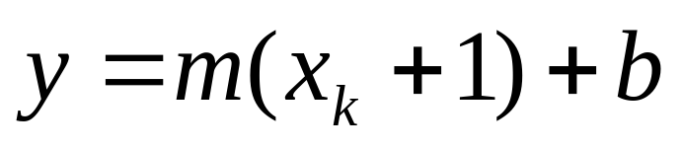
Deriving The Bresenham Line Algorithm
At sample position x_{k}+1 the vertical separations from the mathematical line are labelled d_{upper} and d_{lower}
y_{k+1}
d_{upper}
y
d_{lower}
y_{k}
x_{k}+1
The y coordinate on the mathematical line at x_{k}+1 is:
COMUTER GRAPHICS AND VISUALIZATION, Sougandhika Narayan, Asst Prof, Dept of CSE, KSIT

Slide 17
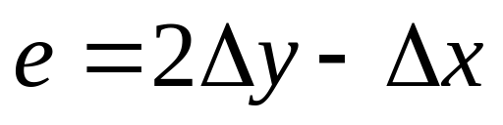
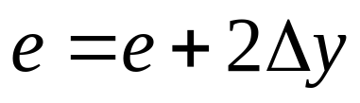
The Bresenham Line Algorithm
BRESENHAM’S LINE DRAWING ALGORITHM
Input the two line end-points, storing the left end-point in (x₁, y₁)
Calculate the constants Δx i.e. dx, Δy i.e. dy, 2Δy and 2 Δx, get the first value for the decision parameter as:
Initialise starting
Initialise i=1 as a counter,
COMUTER GRAPHICS AND VISUALIZATION, Sougandhika Narayan, Asst Prof, Dept of CSE, KSIT

Slide 18
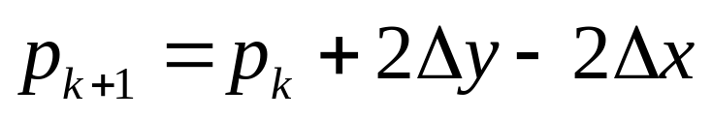
The Bresenham Line Algorithm (cont…)
Otherwise, the next point to plot is (x_{k}+1, y_{k}+1) and:
Repeat step 4 (Δx – 1) times
The algorithm and derivation above assumes slopes are less than 1. for other slopes we need to adjust the algorithm slightly.
COMUTER GRAPHICS AND VISUALIZATION, Sougandhika Narayan, Asst Prof, Dept of CSE, KSIT

Slide 19
Adjustment
For m>1, we will find whether we will increment x while incrementing y each time.
After solving, the equation for decision parameter p_{k} will be very similar, just the x and y in the equation will get interchanged.
COMUTER GRAPHICS AND VISUALIZATION, Sougandhika Narayan, Asst Prof, Dept of CSE, KSIT

Slide 20
Bresenham Example
Let’s have a go at this
Let’s plot the line from (20, 10) to (30, 18)
First off calculate all of the constants:
  Δx: 10
  Δy: 8
  2Δy: 16
  2Δy - 2Δx: -4
Calculate the initial decision parameter p₀:
  p0 = 2Δy – Δx = 6
COMUTER GRAPHICS AND VISUALIZATION, Sougandhika Narayan, Asst Prof, Dept of CSE, KSIT

Slide 21
Bresenham Example (cont…)
k | p_{k} | (x_{k+1},y_{k+1})
0 1 2 3 4 5 6 7 8 9
18
17
16
15
14
13
12
11
10
20
21
22
23
24
25
26
27
28
29
30
COMUTER GRAPHICS AND VISUALIZATION, Sougandhika Narayan, Asst Prof, Dept of CSE, KSIT

Slide 22
Bresenham Exercise
Go through the steps of the Bresenham line drawing algorithm for a line going from (21,12) to (29,16)
COMUTER GRAPHICS AND VISUALIZATION, Sougandhika Narayan, Asst Prof, Dept of CSE, KSIT

Slide 23
Bresenham Exercise (cont…)
k | p_{k} | (x_{k+1},y_{k+1})
0 1 2 3 4 5 6 7 8
18
17
16
15
14
13
12
11
10
20
21
22
23
24
25
26
27
28
29
30
COMUTER GRAPHICS AND VISUALIZATION, Sougandhika Narayan, Asst Prof, Dept of CSE, KSIT

Slide 24
Bresenham Line Algorithm Summary
The Bresenham line algorithm has the following advantages:
  An fast incremental algorithm
  Uses only integer calculations
Comparing this to the DDA algorithm, DDA has the following problems:
  Accumulation of round-off errors can make the pixelated line drift away from what was intended
  The rounding operations and floating point arithmetic involved are time consuming
COMUTER GRAPHICS AND VISUALIZATION, Sougandhika Narayan, Asst Prof, Dept of CSE, KSIT

